Slide 1


INSTITUTE : UIE
DEPARTMENT : CSE
Bachelor of Engineering (Computer Science & Engineering)
WEB AND MOBILE SECURITY (Professional Elective-I)
(20CST/IT-333)
TOPIC OF PRESENTATION:
IIS and LAMP servers.
DISCOVER . LEARN . EMPOWER

Slide 2
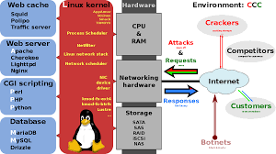
Lecture Objectives
In this lecture, we will discuss:
Introduction to IIS and LAMP servers

Slide 3
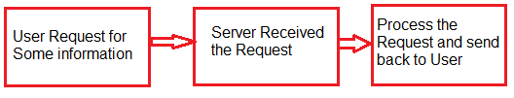
What is IIS?
3
Internet Information Server (IIS) is one of the most popular web servers from Microsoft that is used to host and provide Internet-based services to ASP.NET and ASP Web applications.
Internet Information Server (IIS) has it's own ASP.NET Process Engine to handle the ASP.NET request. The way you configure an ASP.NET application depends on what version of IIS the application is running on.

Slide 4

How IIS works
It works through several different standard languages and protocols. HTML is used for creating a variety of elements. For example, texts, buttons, hyperlinks, and direct/indirect behaviors.
The HTTP (or Hyper Text Transfer Protocol) is used for exchanging the information between the two or more servers and users.
HTTPS --HyperText Transfer Protocol Secure over the SSL (or Secure Sockets Layer) -- uses SSL (secure sockets layer ) to encrypt the communication to add additional data security. The FTP (or File Transfer Protocol ), or its secure variant, FTPS, can transfer files.

Slide 5
Web server Security
A Web service extension is an IIS feature that extends the basic IIS functionality beyond serving static content. Examples of Web service extensions are active server pages (. asp), ASP.NET, and server-side includes (SSI). InstallShield lets you add Web service extensions to your installation. Turn on during configuration.
MIME types in IIS are used to define and allow a specific file type to be served out by IIS. Usually this is used with new media files types, such as FLV, MP4, and etc.
Web services extensions
MIME types
Permissions(scripts, executable)
IP address restrictions
Log file and content
(Configure in IIS manager)
https://www.youtube.com/watch?v=O8L7eMAcXWs

Slide 6
Some of the ways that can be used to harden the IIS to avoid the security breaches are listed below:
Configuration of error pages should be done in such a way that they will display only relevant information about the issues received. The error pages do not display unnecessary information such as IP addresses of servers, user IDs and passwords or any other type of information that can help hackers in exploiting the webserver.
The "URL authorization" must be used in order to apply rules for specific requests e.g., dealing with a particular kind of URLs. URL authorization allows a company to authorize only certain users to view the requested pages.
Any feature of IIS that does not help in reducing the potential attack should be disabled.
The access of domains and IP addresses must be controlled that can reach the webserver.
Always use the firewall to ensure that only valid data package can reach the server.
Whenever Windows gets an update, the Windows operating system should be updated with the latest security patches.
The logging must be used to manage the record of the visitors that access the webserver.

Slide 7
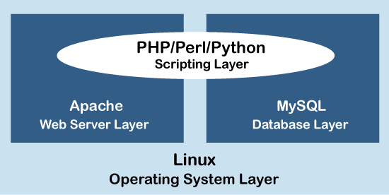
LAMP Server(Lamp Stack)
LAMP is an open-source Web development platform that uses Linux as the operating system, Apache as the Web server, MySQL as the relational database management system and PHP/Perl/Python as the object-oriented scripting language.
LAMP has classic layered architecture, with Linux at the lowest level. The next layer is Apache and MySQL, followed by PHP. Although PHP is at the top or presentation layer, the PHP component sits inside Apache.
The LAMP stack order of execution shows how the elements interoperate. The process starts when the Apache webserver receives requests for web pages from a user's browser. If the request is for a PHP file, Apache passes the request to PHP, which loads the file and executes the code contained in the file. PHP also communicates with MySQL to fetch any data referenced in the code.

Slide 8
What is Apache?
Apache, or The Apache HTTP web server, is an open source Web server application managed by the Apache Software Foundation.
The server software is freely distributed, and the open source license means users can edit the underlying code to tweak performance and contribute to the future development of the.
Although we call Apache a web server, it is not a physical server, but rather a software that runs on an HTTP server. Its job is to establish a connection between a server and the browsers of website visitors (Firefox, Google Chrome, Safari, etc.) while delivering files back and forth between them (client-server structure). The Apache software is also compatible with any operating system, from Windows to Unix.
The server and the client communicate through the HTTP protocol, and the Apache web server is responsible for the smooth and secure communication between the two machines.
Support, fixes and development are handled by the loyal user community and coordinated by the Apache Software Foundation.

Slide 9
Working Features
The Apache web server has modules which add more functions to its software, such as MPM (for handling multi-processing modes) or mod_ssl for enabling SSL v3 and TLS
.htaccess : The .htaccess file is a basic configuration file used by the Apache web server to let you create special rules that tell your web server how to function. It located in the root folder. To configure Apache, you’ll need to access .htaccess.
IPv6, FTP, HTTP/2 .
Some high-profile companies using Apache include Cisco, IBM, Salesforce, General Electric, Adobe, VMware, Xerox, LinkedIn, Facebook, Hewlett-Packard, AT&T, Siemens, eBay, and many more.
Because Apache doesn’t perform as well in some benchmarks, especially for static websites or websites with high traffic, Kinsta uses the NGINX web server instead of Apache.

Slide 10
Security Practices
Disable Trace HTTP Request
Restrict Access to a Specific Network or IP
Use only TLS 1.2
Disable Directory Listing
Disable Null and Weak Ciphers
Always upgrade to the latest stable version of Apache.
https://geekflare.com/10-best-practices-to-secure-and-harden-your-apache-web-server/

Slide 11
Apache Pros and Cons
Pros:
Open-source and free, even for commercial use.
Reliable, stable software.
Frequently updated security patches.
Flexible due to its module-based structure.
Easy to configure, beginner-friendly.
Cross-platform (works on both Unix and Windows servers).
Optimal deliverability for static files and compatibility with any programming language (PHP, Python, etc)
Works out of the box with WordPress sites.
Huge community and easily available support in case of any problem.
Cons:
Performance problems on extremely traffic-heavy websites.

Slide 12
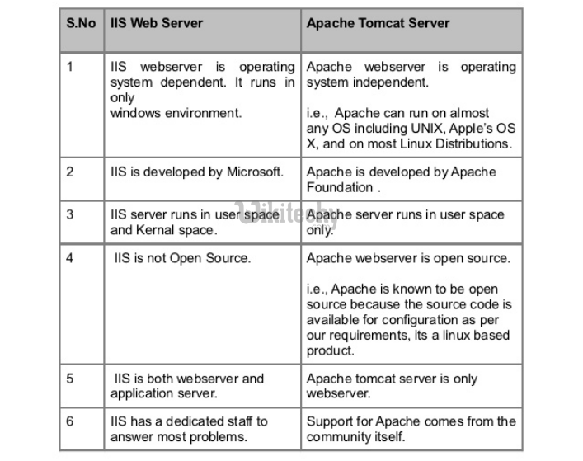
IIS Vs Apache

Slide 13
Accessing Web Servers
Request documents from Web servers
know the Host names
Local Web servers
Access through machine name or localhost
Remote Web servers
Access through machine name
Domain name or Internet Protocol (IP) address
Domain name server (DNS): Computer that maintains a database of host names and their corresponding IP address

Slide 14
Web Resources
www.microsoft.com/msdownload/ntoptionpack/askwiz.asp
www.w3.org/Protocols
www.apache.org
httpd.apache.org
httpd.apache.org/docs-2.0
www.apacheweek.com
linuxtoday.com/stories/18780.html
www.iisanswers.com
www.iisadministrator.com

Slide 15
References:
Books:
Web Design With HTML, CSS, JavaScript and jQuery Set, 1st Edition, by Jon Duckett.
Hacking Exposed Web Applications, 3rd edition, Joel Scambray, Vincent Liu, Caleb Sima, Released October 2010, Publisher(s): McGraw-Hill
Video Lectures :
https://www.techtarget.com/searchwindowsserver/definition/IIS
https://www.youtube.com/watch?v=vazRx1Ei8VA
Reference Links:
https://www.upguard.com/blog/iis-apache
https://www.h2kinfosys.com/blog/web-servers-apache-web-server-iis/
http://www.uh.edu/~smiertsc/2336itec/Deitel_21Ch.pdf
http://www.differencebetween.net/technology/difference-between-iis-and-apache/

Slide 16

THANK YOU

